Slide 1


De novo RNA-Seq Assembly and Transcriptome Studies using Trinity with Applications towards Non-model Organism Studies
Brian Haas
Broad Institute
Workshop in Genomics, Cesky Krumlov, Jan 2016

Slide 2
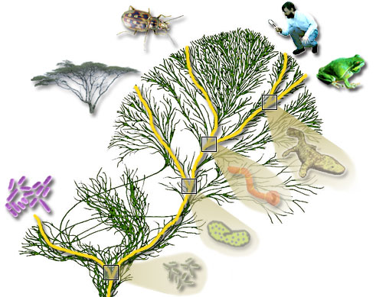
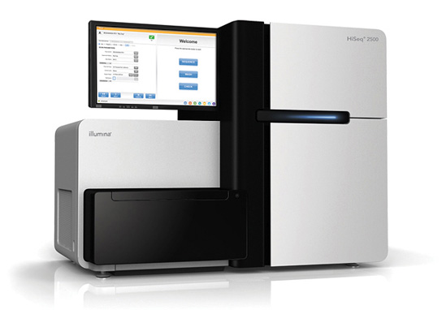
RNA-Seq Empowers Transcriptome Studies
Extract RNA, convert to cDNA
Next-gen Sequencer
(pick your favorite)
Notes:
RNA-Seq is a powerful technology for identifying genes and profiling gene expression in any living organism.
----
It just requires that you can collect RNA from your sample of interest.
----
Sequencing the transcriptome on your favorite next-gen sequencer will often generate millions of reads, but the reads tend to be much shorter than the original transcript.
----
Some of the key challenges in analyzing these data include inferring the full-length transcript sequence from which the shorter reads were derived, and to accurately estimate the transcript expression levels.

Slide 3
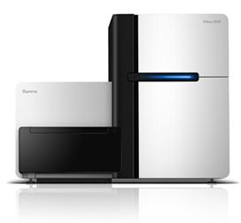
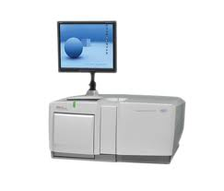
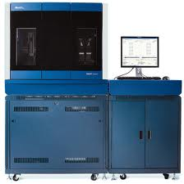
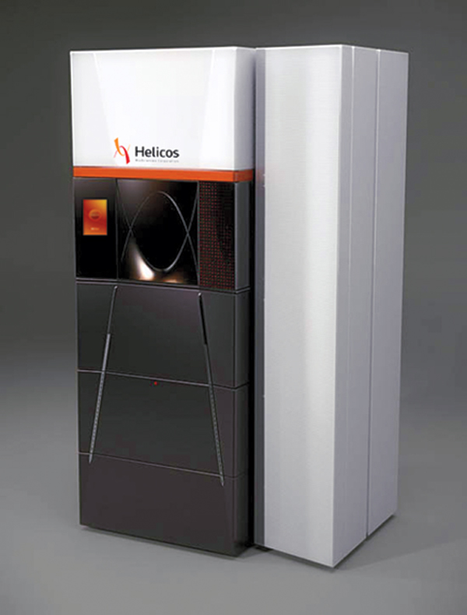
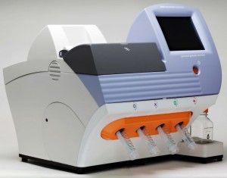
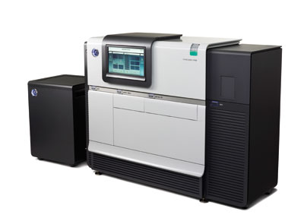
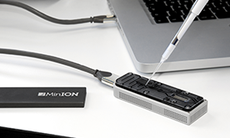
Generating RNA-Seq: How to Choose?
Many different instruments hit the scene in the last decade
Illumina
454
SOLiD
Helicos
Ion Torrent
Pacific Biosciences
Oxford Nanopore
Slide courtesy of Joshua Levin, Broad Institute.

Slide 4
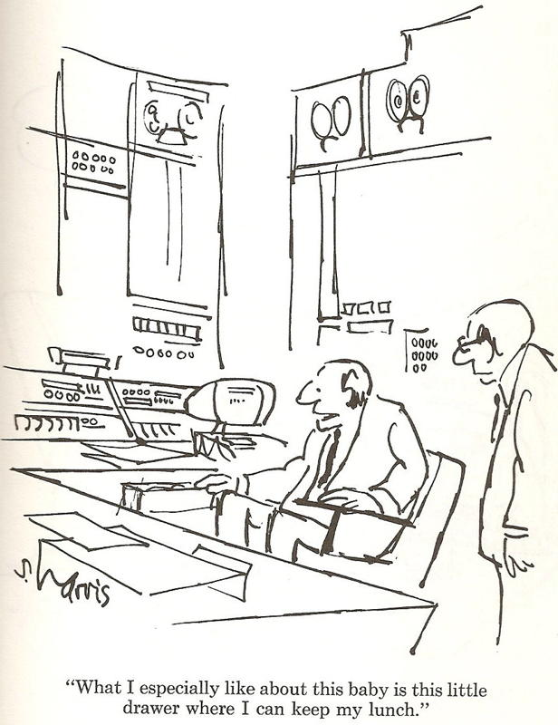
RNA-Seq: How to Choose?
Illumina
454
SOLiD
Helicos
Ion Torrent
Pacific Biosciences
Oxford Nanopore
Slide courtesy of Joshua Levin, Broad Institute.

Slide 5
Generating RNA-Seq: How to Choose?
Popular choices for RNA-Seq today
Illumina
454
SOLiD
Helicos
Ion Torrent
Pacific Biosciences
Oxford Nanopore

Slide 6
Generating RNA-Seq: How to Choose?
Popular choices for RNA-Seq today
[Current RNA-Seq workhorse]
[Newly emerging technology for full-length single molecule sequencing]
Illumina
454
SOLiD
Helicos
[Full-length single molecule sequencing]
Ion Torrent
Pacific Biosciences
Oxford Nanopore

Slide 7
RNA-Seq: How do we make cDNA?
Prime with Random Hexamers (R6)
mRNA
5’
3’
R₆
R₆
R₆
Reverse transcriptase
cDNA First strand synthesis
R₆
R₆
R₆
RNase H
DNA polymerase
DNA Ligase
cDNA Second strand synthesis
Illumina cDNA Library
Slide courtesy of Joshua Levin, Broad Institute.

Slide 8
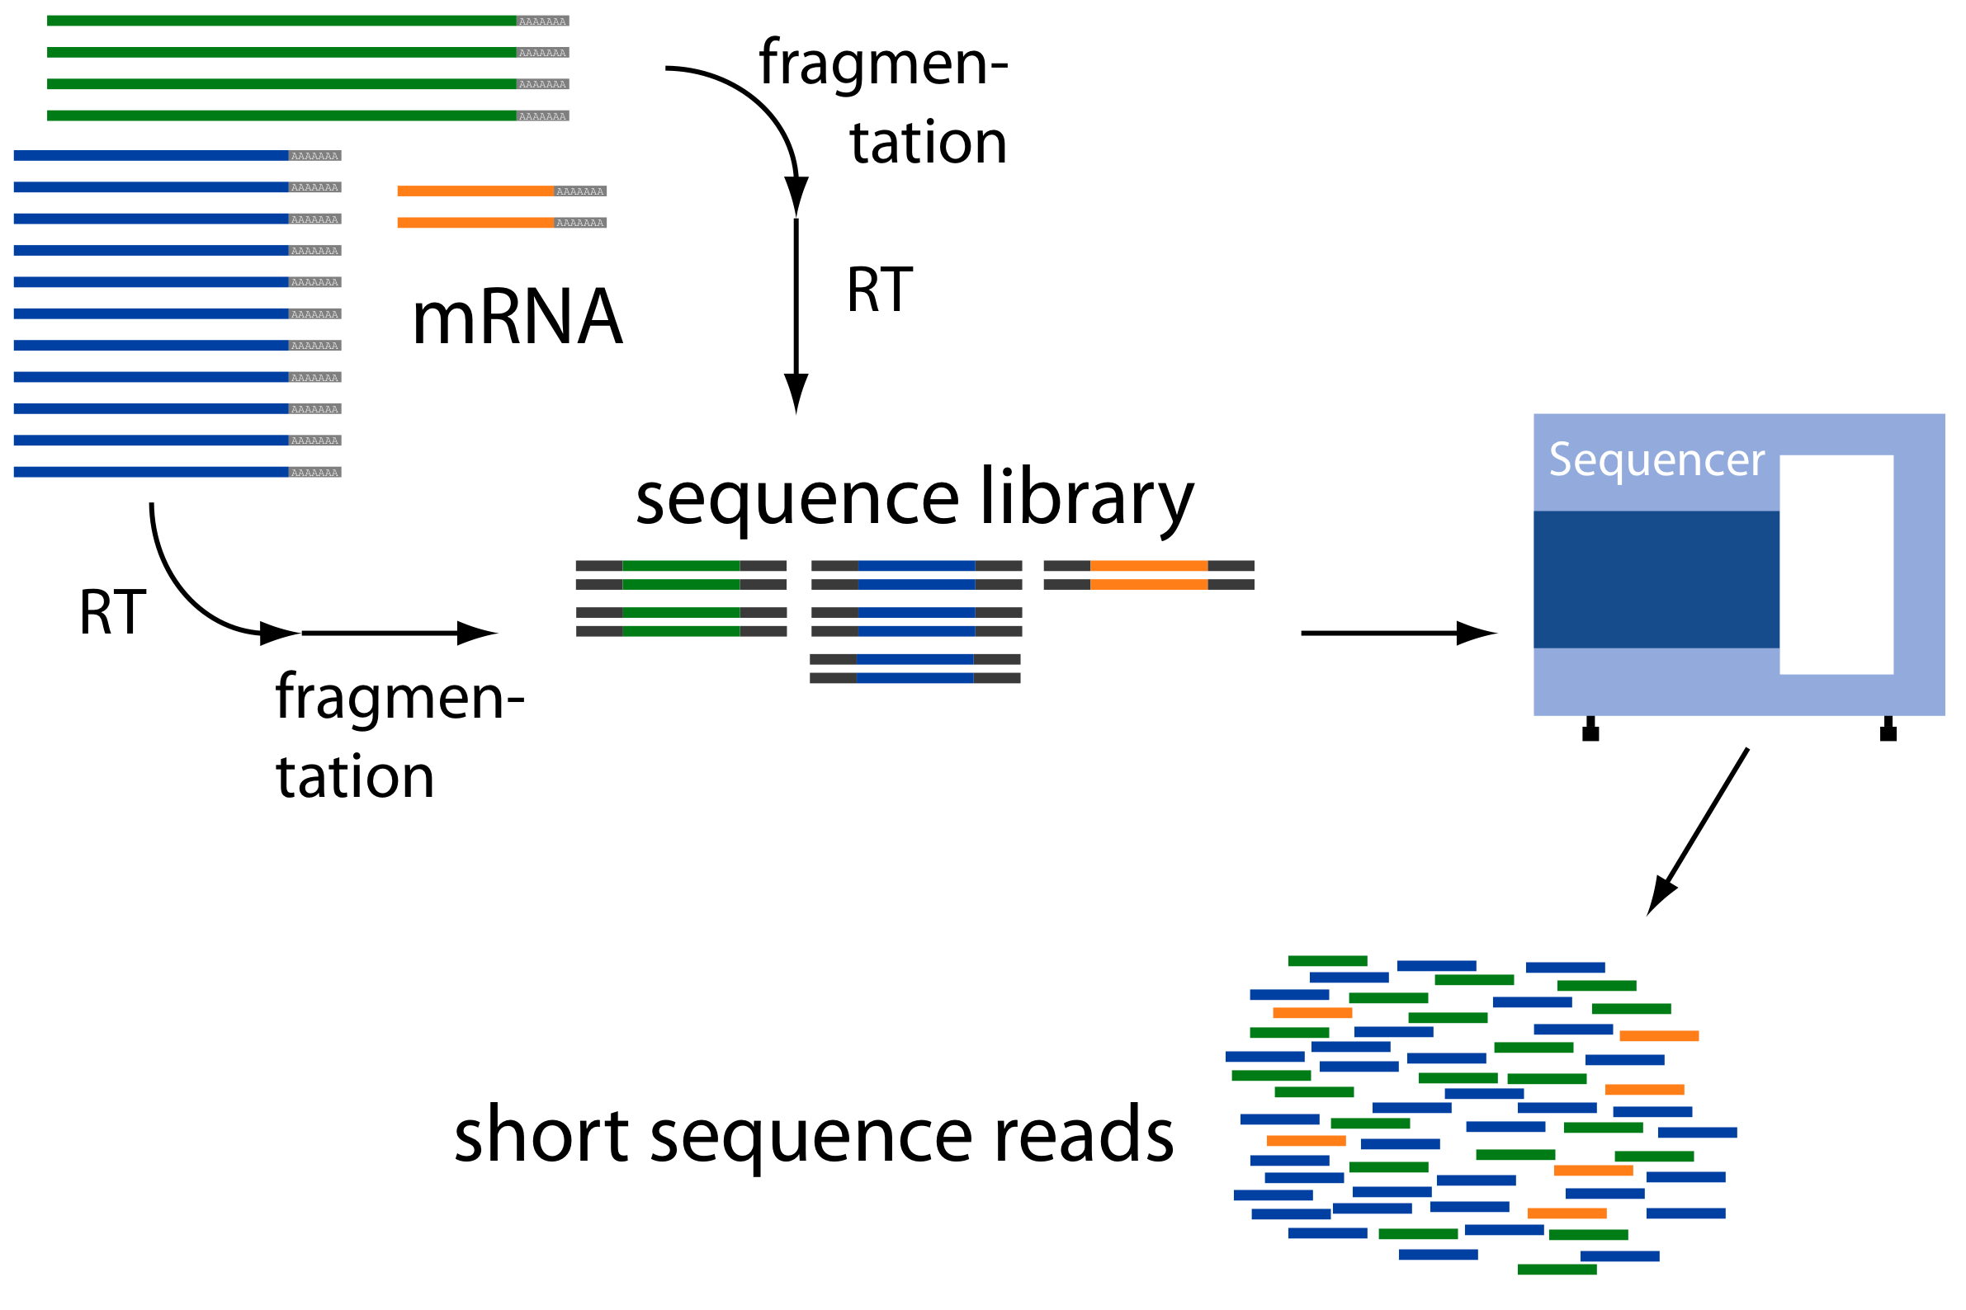
Overview of RNA-Seq
From: http://www2.fml.tuebingen.mpg.de/raetsch/members/research/transcriptomics.html

Slide 9
Common Data Formats for RNA-Seq
FASTA format:
>61DFRAAXX100204:1:100:10494:3070/1
AAACAACAGGGCACATTGTCACTCTTGTATTTGAAAAACACTTTCCGGCCAT
FASTQ format:
@61DFRAAXX100204:1:100:10494:3070/1
AAACAACAGGGCACATTGTCACTCTTGTATTTGAAAAACACTTTCCGGCCAT
+
ACCCCCCCCCCCCCCCCCCCCCCCCCCCCCBC?CCCCCCCCC@@CACCCCCA
Read
Quality values
AsciiEncodedQual(x) = -10 * log10(Pwrong(x)) + 33
AsciiEncodedQual (‘C’) = 64
So, Pwrong(‘C’) = 10^( (64-33/ (-10) ) = 10^-3.4 = 0.0004

Slide 10
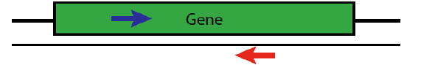
Paired-end Sequences
Two FastQ files, read name indicates left (/1) or right (/2) read of paired-end
@61DFRAAXX100204:1:100:10494:3070/1
AAACAACAGGGCACATTGTCACTCTTGTATTTGAAAAACACTTTCCGGCCAT
+
ACCCCCCCCCCCCCCCCCCCCCCCCCCCCCBC?CCCCCCCCC@@CACCCCCA
@61DFRAAXX100204:1:100:10494:3070/2
CTCAAATGGTTAATTCTCAGGCTGCAAATATTCGTTCAGGATGGAAGAACA
+
C<CCCCCCCACCCCCCCCCCCCCCCCCCCCCCCCCCCCCCCCCCCCCCBCCCC

Slide 11
Overview of RNA-Seq
Reconstruct original full-length transcripts
From: http://www2.fml.tuebingen.mpg.de/raetsch/members/research/transcriptomics.html

Slide 12
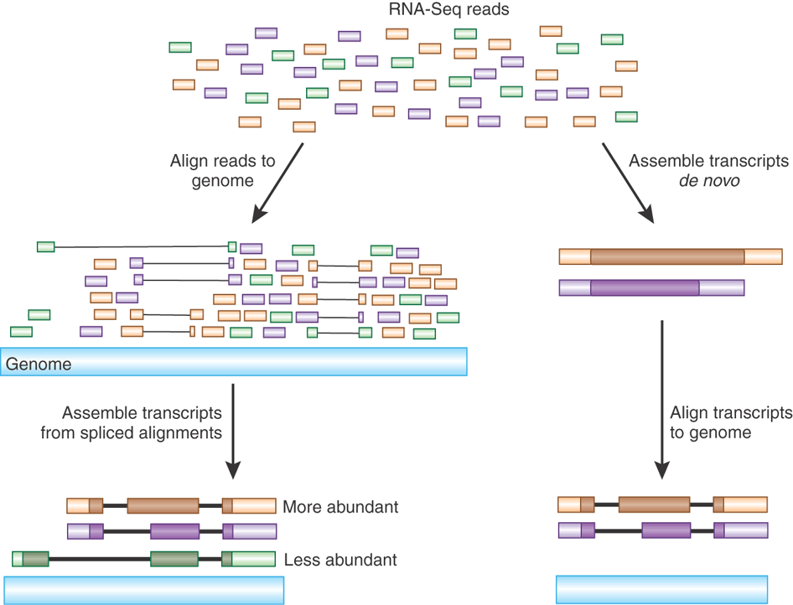
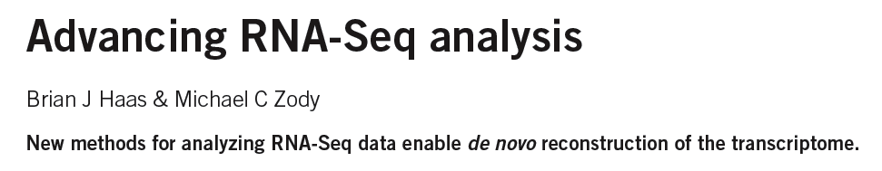
Transcript Reconstruction from RNA-Seq Reads
Nature Biotech, 2010
Notes:
One of the primary goals in RNA-Seq studies is to reconstruct the transcripts from which the short reads were derived, and transcript reconstruction is often a prerequisite to downstream studies such as genome annotation or diifferential expression analysis.
Two general strategies have been explored for reconstructing transcripts from RNA-Seq reads.

Slide 13
Transcript Reconstruction from RNA-Seq Reads
TopHat
Notes:
One strategy requires having a reference genome and involves first aligning reads to the genome using a spliced aligner.

Slide 14
Transcript Reconstruction from RNA-Seq Reads
TopHat
Cufflinks
Notes:
Then, the alignments, instead of the original reads, are assembled into transcript structures.

Slide 15

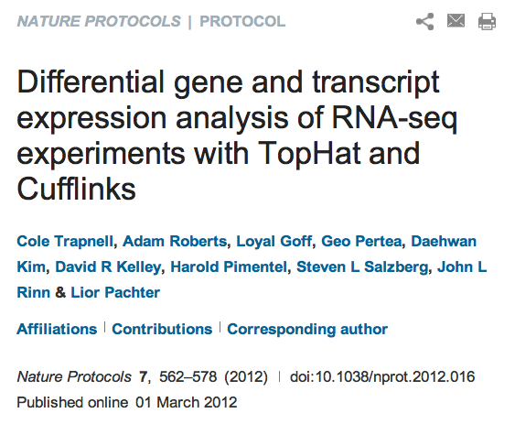

Transcript Reconstruction from RNA-Seq Reads
Trinity
TopHat
The Tuxedo Suite:
End-to-end Genome-based RNA-Seq Analysis Software Package
Cufflinks
GMAP
Notes:
Then, if a genome sequence is available, the assembled transcripts can be aligned to the genome to reveal individual introns and exons.

Slide 16
Transcript Reconstruction from RNA-Seq Reads
Trinity
TopHat
The Tuxedo Suite:
End-to-end Genome-based RNA-Seq Analysis Software Package
Non-model organisms:
“I don’t have a reference genome!”
Cufflinks
GMAP
Notes:
Then, if a genome sequence is available, the assembled transcripts can be aligned to the genome to reveal individual introns and exons.

Slide 17
Transcript Reconstruction from RNA-Seq Reads
TopHat
Trinity
Cufflinks
Notes:
An alternative strategy doesn’t require a reference genome and involves assembling the read sequences directly.

Slide 18
Transcript Reconstruction from RNA-Seq Reads
TopHat
Trinity
Cufflinks
GMAP
Notes:
Then, if a genome sequence is available, the assembled transcripts can be aligned to the genome to reveal individual introns and exons.

Slide 19

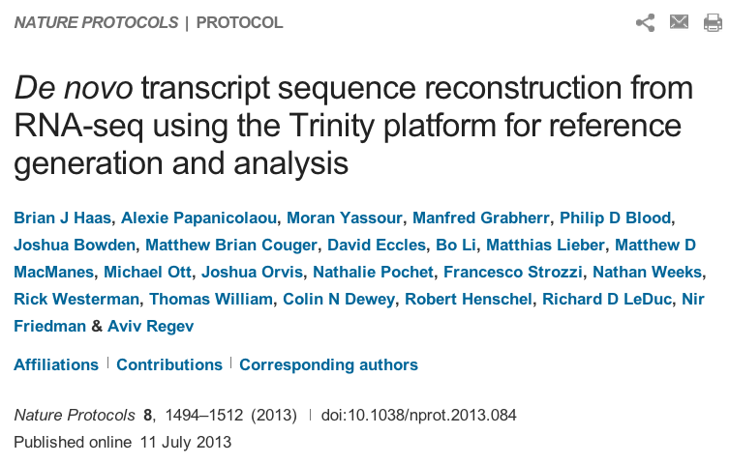
Transcript Reconstruction from RNA-Seq Reads
End-to-end Transcriptome-based RNA-Seq Analysis Software Package
Trinity
GMAP
Notes:
Trinity is a software tool that I helped develop, and which we published last year in Nature Biotechnology.
In this talk, I’ll describe how Trinity works, and describe some of the applications that we aim to support.

Slide 20
The General Approach to De novo RNA-Seq Assembly Using De Bruijn Graphs
Notes:
In these next sections, I’ll provide an overview of the Trinity assembly algorithm.
It’s not necessary to understand all the details of the Trinity algorithm in order to effectively use the software. If you want to, you can think of it as a black box with read sequences as input and assembled transcript contigs as output, but it is useful to understand what is happening at the various stages of the assembly when monitoring its execution or trying to troubleshoot various aspects of its behavior.

Slide 21
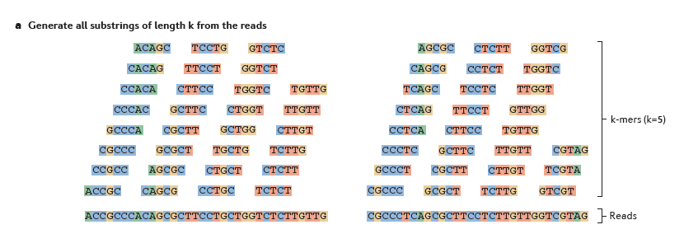
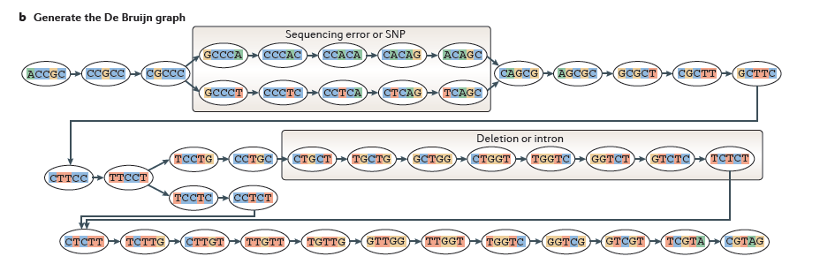
Sequence Assembly via De Bruijn Graphs
From Martin & Wang, Nat. Rev. Genet. 2011
Notes:
The first step in a de Bruijn graph-based assembly is to construct the de Bruijn graph from the sequence reads.
Each read is decomposed into substrings of some specified length k. Each word of length k is called a k-mer. In this example, k is set to 5, so here each 5-mer is extracted from the read. An ordered list of k-mers is generated by scanning a window of length k across the length of the read. You’ll notice that each k-mer overlaps the next k-mer by exactly k-1 bases.
--
Then, a de Bruijn graph is constructed by assigning each unique k-mer as a node in the graph and connecting immediately overlapping k-mers by an edge. This is a very effective and compact way of representing the sequence data within the reads. For example, hundreds of millions of reads can be sequenced, and the identical sequence regions within reads become compressed into individual nodes within the graph.
At positions where related sequences diverge due to allelic polymorphisms, splicing variations, repeats, or due to sequencing errors, the graph will branch and can form bulges or loops.

Slide 22
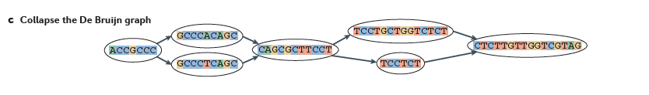
From Martin & Wang, Nat. Rev. Genet. 2011
Notes:
After building the graph from all the reads, the graph is typically pruned to remove bubbles and structures that likely stem from sequencing errors,
--
and the graph is compacted by collapsing those nodes that form linear unbranched chains of overlapping k-mers.
--
For example, this linear chain of kmers is compressed into a single node in the compacted graph.

Slide 23
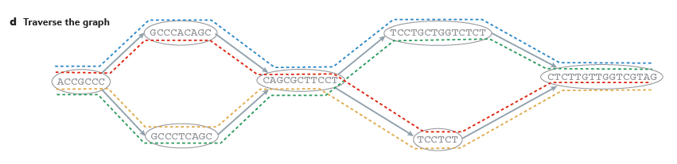
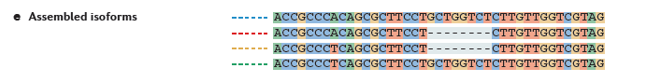
From Martin & Wang, Nat. Rev. Genet. 2011
Notes:
Now, to reconstruct transcripts, paths are traversed across the graph.
--
In this example, there are four possible paths from the beginning to the end of the graph, each path shown traced by a different color.
By traversing each path, a different transcript sequence is generated.
--
In this case, each of the four differently colored paths generates a different sequence as shown.
By taking into account the paths that the reads trace through the graph, along with any mate-pairing information, constraints can be placed such that not all possible path combinations are reported, but instead only those paths that are best supported by the RNA-seq reads.

Slide 24

Contrasting Genome and Transcriptome Assembly
Genome Assembly
Transcriptome Assembly
Uniform coverage
Single contig per locus
Double-stranded
Exponentially distributed coverage levels
Multiple contigs per locus (alt splicing)
Strand-specific
Notes:
Both genome and transcriptome assemblers leverage the de Bruijn graph structure, but are tuned to assemble reads according to very different expected characteristics. This is why you wouldn’t want to leverage a genome assembler for transcriptome assembly and vice-versa, since each method is highly specialized.
Some of the key differences between genome and transcriptome assemblers include the following:
--
Genome assemblers expect that read coverage is going to be rather uniform and will often discard sequences that occur at high coverage as repetitive sequences. Transcriptome assembly needs to consider a wide range of coverage levels spanning several orders of magnitude since sequences with high coverage are more likely to represent highly expressed transcripts instead of repeats.
--
Genome assemblers aim to generate a single contig per locus, possibly two if tuned to separate haplotypes in a polymorphic genome assembly. In transcriptome assembly, it’s understood that single genes can generate many alternatively spliced transcripts, and multiple contigs are reported per locus where evidence of transcript complexity exists.
--
Finally, in genome assembly, reads are assumed to be derived from either strand of the double-stranded DNA molecule. Given strand-specific RNA-Seq reads, Transcriptome assemblers should aim to assemble sense and antisense transcripts separately.
--
Trinity, of course, was developed to take all of these properties into account.

Slide 25
Trinity Aggregates Isolated Transcript Graphs
Genome Assembly
Single Massive Graph
Trinity Transcriptome Assembly
Many Thousands of Small Graphs
Entire chromosomes represented.
Ideally, one graph per expressed gene.
Notes:
A significant difference between Trinity as compared to all other assemblers is how it goes about building the graphs.
Genome assemblers (and other transcriptome assemblers that are built on top of genome assemblers) typically build single large graphs.
Trinity instead tries to partition the data into many thousands of small graphs, ideally one graph per expressed gene. This is possible because most expressed transcripts tend to be non-overlapping.
Having many small graphs lends itself to massive parallel processing, which is an added computational benefit.

Slide 26
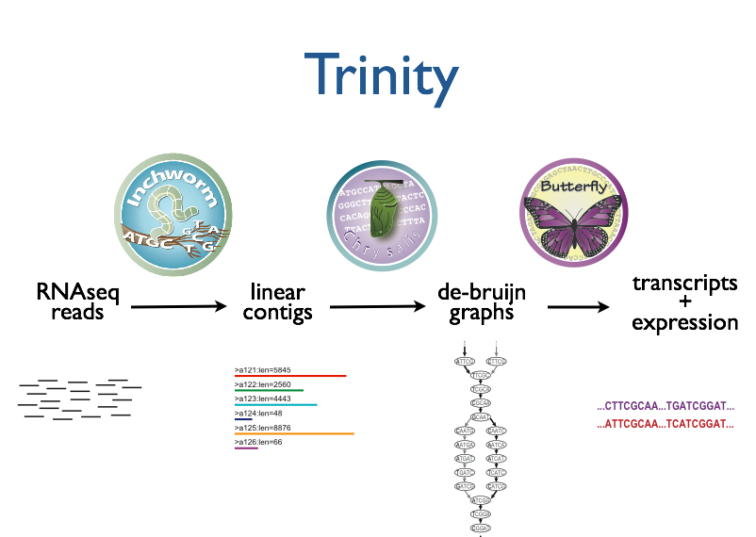



Trinity – How it works:
RNA-Seq reads
Linear
contigs
de-Bruijn
graphs
Transcripts
+
Isoforms
Thousands of disjoint graphs
Notes:
Here’s a high-level overview of the whole Trinity assembly algorithm.
We call it Trinity because it involves three major steps that we’ve built into three separate software modules.
It starts with Inchworm, which first assembles the RNA-Seq data into linear contigs.
Then, Chrysalis groups contigs that are related due to alternative splicing or gene duplication and constructs de bruijn graphs.
Finally, Butterfly examines reads in the context of the de bruijn graphs, and reports the final full-length transcripts and isoforms of transcripts.

Slide 27
Inchworm Algorithm
Decompose all reads into overlapping Kmers (25-mers)
Identify seed kmer as most abundant Kmer, ignoring low-complexity kmers.
Extend kmer at 3’ end, guided by coverage.
G
A
GATTACA
9
T
C
Notes:
The inchworm algorithm works as follows:
It first decomposes reads into a catalog of overlapping Kmers. By default we use overlapping 25-mers. This is similar to the first step of generating a de Bruijn graph, but we don’t actually build a de Bruijn graph. We just store the k-mers and their frequency in all the reads, and don’t store the edges between k-mers. This is done mainly to save on the amount of memory and computation required.
The single most abundant kmer with reasonable sequence complexity is identified as a seed kmer.
This seed kmer is then extended at the 3’ end guided by the coverage of overlapping kmers.
For each extension, there are four possible kmers, each ending with one of the four possible nucleotides.

Slide 28
Inchworm Algorithm
G
4
A
GATTACA
9
T
C
Notes:
Each of the possible overlapping kmers is looked up in the kmer catalog to determine their frequency within the reads.
In this toy example, the kmer ending with ‘G’ is found 4 times.

Slide 29
Inchworm Algorithm
G
4
A
GATTACA
1
9
T
C
Notes:
‘A’ is found once.

Slide 30
Inchworm Algorithm
G
4
A
GATTACA
1
9
T
0
C
Notes:
The kmer ending with ‘T’ doesn’t exist in the reads, so it has a count of zero.

Slide 31
Inchworm Algorithm
G
4
A
GATTACA
1
9
T
0
C
4
Notes:
And the kmer ending with ‘C’ is found 4 times.

Slide 32
Inchworm Algorithm
G
4
A
GATTACA
1
9
T
0
C
4
Notes:
In this case we have a tie.

Slide 33
Inchworm Algorithm
G
A
0
5
T
1
G
4
C
A
0
GATTACA
1
9
T
0
G
C
1
4
A
1
C
T
1
1
Notes:
When we encounter a tie, we explore the tied paths recursively to find that extension that provides the highest cumulative coverage.

Slide 34
Inchworm Algorithm
G
A
0
5
T
1
G
4
C
A
0
GATTACA
1
9
T
0
G
C
1
4
A
1
C
T
1
1
Notes:
In this case, the extension of two overlapping kmers ending with an ‘A’ provides the highest cumulative coverage, and so the other paths are ignored.

Slide 35
Inchworm Algorithm
A
5
G
4
GATTACA
9
Notes:
Extensions continue to occur in this way until there are no more kmers that provide for an extension.

Slide 36
Inchworm Algorithm
A
5
C
G
0
4
T
0
GATTACA
A
9
6
G
1
Notes:
Then, we extend from right to left in the same manner, following the path of greatest coverage.

Slide 37
Inchworm Algorithm
A
5
G
4
GATTACA
A
9
6
A
7
Report contig: ….AAGATTACAGA….
Remove assembled kmers from catalog, then repeat the entire process.
Notes:
Once the extension completes, the assembled contig is reported.
--transition—
The kmers found in the contig are removed from the kmer catalog, and the entire process is repeated starting from a new seed. The Inchworm assembly ends when the entire k-mer catalog has been depleted.

Slide 38
Inchworm Contigs from Alt-Spliced Transcripts
Expressed isoforms
Isoform A
Isoform B
Notes:
Inchworm alone performs well at reconstructing full-length transcripts, but in the case of alternative splicing, inchworm alone is unable to reconstruct full-length transcripts for each of the isoforms.
This is because it assembles contigs from unique kmers and the sequences shared between isoforms can be reported in only one Inchworm contig.
For example, here are two expressed isoforms which share the orange and green sequence regions in common, and Isoform A has a stretch of unique sequence shown in yellow, such as coming from an exon skipped in isoform B.

Slide 39

Inchworm Contigs from Alt-Spliced Transcripts
Expressed isoforms
Expression
Isoform A
(low)
Isoform B
(high)
Graphical representation
Notes:
This can be represented graphically like so. Based on the read support, we find that Isoform B is highly expressed as compared to Isoform A, and we indicate that in the graph by the thicker edge.

Slide 40
Inchworm Contigs from Alt-Spliced Transcripts
Notes:
When Inchworm greedily assembles k-mers, it will often report the more highly expressed isoform as a single full-length contig.

Slide 41
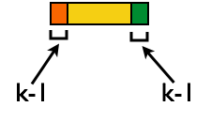
Inchworm Contigs from Alt-Spliced Transcripts
+
No k-mers in common
Notes:
And only the unique regions of alternatively spliced isoforms are reported as separate contigs.
Again, these contigs share no k-mers in common.
The remaining components of Trinity are responsible for linking these related contigs together and reporting more complete sequences for each. This is where Chrysalis first comes in.

Slide 42
Inchworm Contigs from Alt-Spliced Transcripts
+
Notes:
Although these inchworm contigs lack complete kmers in common, they maintain partial kmer overlap at points where the isoforms diverge.
The smaller contig can still be associated with the larger contig based on these partial kmers of length k-1, and we can find reads to support the junction.

Slide 43
Chrysalis Re-groups Related Inchworm Contigs
+
Chrysalis uses (k-1) overlaps and read support to link related Inchworm contigs
Notes:
The Chrysalis tool, in the next step, exploits these partial kmers to regroup related contigs. If reads exist that support the junction at the k-1 overlaps, then Chrysalis will cluster the inchworm contigs together.

Slide 44
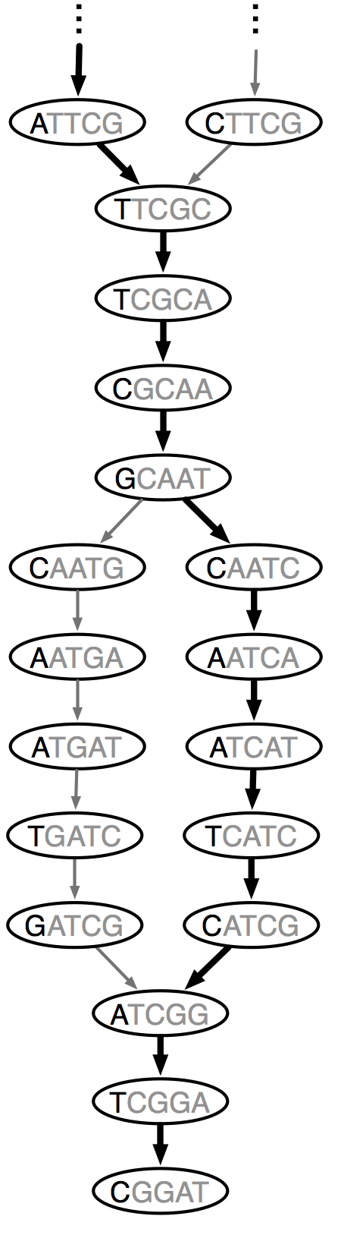
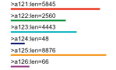
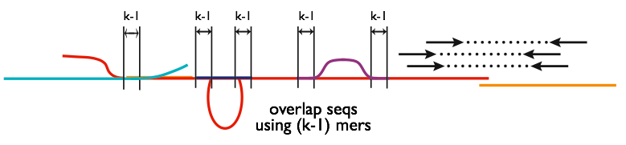
Chrysalis
Integrate isoforms
via k-1 overlaps
Build de Bruijn Graphs
(ideally, one per gene)
Notes:
Here is a high-level overview of the Chrysalis operations.
Chrysalis clusters related contigs based on these k-1mer overlaps.
Chyrsalis also leverages read pairing information to join minimally overlapping contigs.
--
After identifying the connected inchworm contigs, it constructs a separate de Bruijn graph for each group.
(Again, the de Bruijn graph represents the overlaps between adjacent kmers in the sequences with branches at sites of variation.)

Slide 45
Thousands of Chrysalis Clusters
Notes:
And this is how we end up with many separate graphs, ideally one graph per gene, with each graph representing the transcriptional complexity at that locus.
These graphs can then be processed in a parallel fashion by the next step of Trinity involving Butterfly.

Slide 46
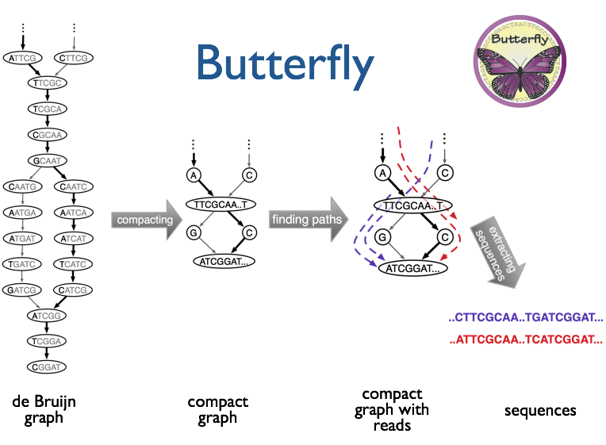
(isoforms and paralogs)
Notes:
Butterfly operates on each of these graphs independently.
It first compacts the de Bruijn graph by collapsing the unbranched stretches, as described earlier.
It then threads the original sequencing reads into the graph, tracking the paths occupied by the reads and those paths supported by mate pairs.
Butterfly then reports the most probable paths through the graph supported by the reads and read pairings, emitting full-length transcripts for isoforms and paralogs.

Slide 47
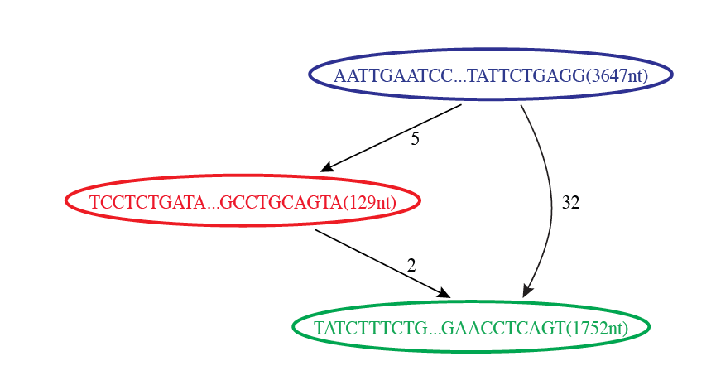

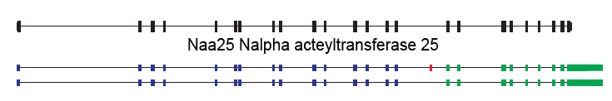
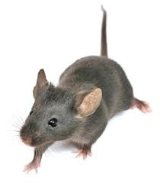
Butterfly Example 1: Reconstruction of Alternatively Spliced Transcripts
Butterfly’s Compacted Sequence Graph
Reconstructed Transcripts
Aligned to Mouse Genome
Notes:
Here’s a real example to demonstrate how this works in practice.
In our mouse RNA-Seq data set, we find a compacted de Bruijn graph that has three nodes.

Slide 48
Reconstruction of Alternatively Spliced Transcripts
Butterfly’s Compacted Sequence Graph
Reconstructed Transcripts
Aligned to Mouse Genome
Notes:
By traversing the path from the top blue node to the bottom green node, we generate a single transcript sequence.

Slide 49
Reconstruction of Alternatively Spliced Transcripts
Butterfly’s Compacted Sequence Graph
Reconstructed Transcripts
Aligned to Mouse Genome
Notes:
By traversing the alternative path through the red node, we generate another transcript sequence. This second transcript shares the blue and green segments, but contains an additional internal red segment.

Slide 50
Reconstruction of Alternatively Spliced Transcripts
Butterfly’s Compacted Sequence Graph
Reconstructed Transcripts
Aligned to Mouse Genome
(Reference structure)
Notes:
From mapping the transcripts to the reference genome sequence we can see that the inserted sequence actually corresponds to a cassette exon that is alternatively spliced, and novel given that it wasn’t found in the reference transcript structure.

Slide 51
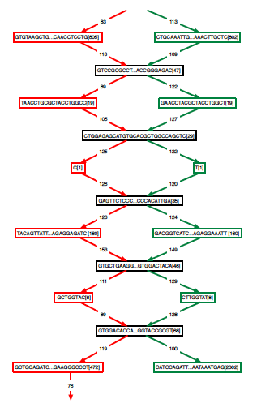
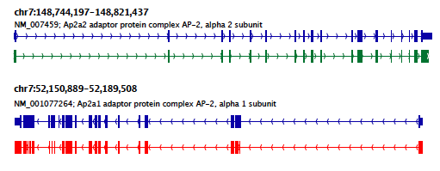
Teasing Apart Transcripts of Paralogous Genes
Butterfly Example 2:
Ap2a1
Ap2a2
Notes:
Some transcript graphs are far more complex.
Here we have an example of two such transcripts derived from paralogous genes that became intertwined in the compacted graph due to stretches of sequence identity among segments of the transcripts.
Shared sequences are represented by the central sequence nodes and paralog-specific sequences are represented by branched nodes.
By tracing consistent paths of reads through the graph, Butterfly is able to tease apart the paralogous gene sequences and report the individual transcripts. In this case, the green path yields one of the transcripts and the red path yields the other.

Slide 52
Teasing Apart Transcripts of Paralogous Genes
Ap2a1
Ap2a2
Notes:
These transcripts, when mapped to the mouse genome match perfectly with the reference gene structures. Here, the reference structures are shown in blue, and the Trinity-reconstructed transcripts are shown below.

Slide 53
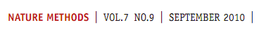
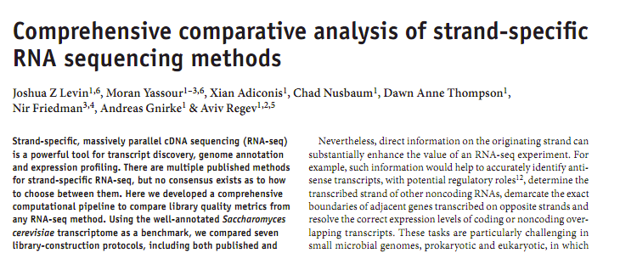
Strand-specific RNA-Seq is Preferred
Computationally: fewer confounding graph structures in de novo assembly:
ex. Forward != reverse complement
(GGAA != TTCC)
Biologically: separate sense vs. antisense transcription
‘dUTP second strand marking’ identified as the leading protocol
Notes:
Although Trinity doesn’t absolutely require it, Strand specific rna-seq is the preferred substrate for transcriptome assembly.
Computationally, there are fewer confounding graph structures since forward kmers and the reverse complement kmers are treated as distinct.
Biologically, it’s important because it allows for the separation of sense and antisense transcription.
--
Our group at the Broad performed a study of the various methods for generating strand-specific RNA-Seq,
--
and we found the ‘dUTP second strand marking’ method to be the leading protocol.
We routinely generate strand-specific RNA-Seq as our default protocol at the Broad, and there are now kits available that make the approach readily accessible.

Slide 54
dUTP 2nd Strand Method: Our Favorite
RNA
First-strand synthesis with normal dNTPs
cDNA
Second-strand synthesis with dTTP → dUTP
U
U
UU
U
UU
Adaptor ligation
U
U
UU
U
UU
U
U
UU
U
UU
USER™
(Uracil-Specific Excision Reagent)
Remove “U”s
PCR and paired-end sequencing
Modified from Parkhomchuk et al. (2009) Nucleic Acids Res. 37:e123
Slide courtesy of Joshua Levin, Broad Institute.

Slide 55
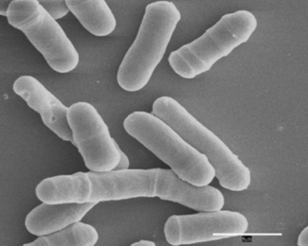
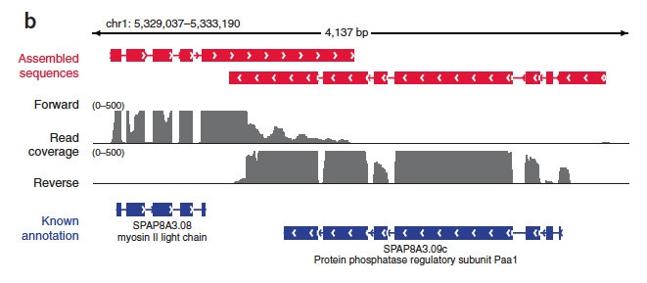
Overlapping UTRs from Opposite Strands
Schizosacharomyces pombe
(fission yeast)
Notes:
Strand-specific RNA-Seq is tremendously useful when applied to organisms that have compact genomes.
Here’s an example from Schizosaccharomyces pombe (fission yeast) where we have two known genes that are transcribed on opposite strands and point toward each other.
We have strand specific rna-seq and the coverage plots for each strand are shown above. From the coverage plots, you can see that there’s overlap in the coverage in their UTR regions, and if we didn’t have strand-specific data, then we’d reconstruct a single transcript that covers both genes. Because we have the strand-specific data, though, Trinity is able to separately reconstruct these transcripts, allowing for overlap among their UTRs.

Slide 56
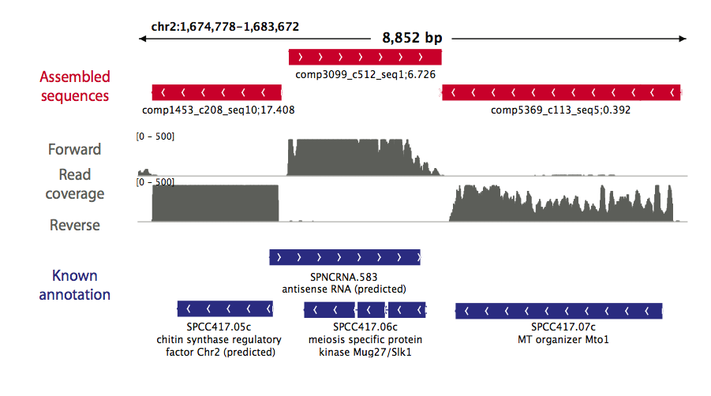
Antisense-dominated Transcription
Notes:
Here’s another example in fission yeast that highlights the importance of strand-specific rna-seq.
This region of the genome encodes three genes that are all encoded on the same strand. From the rna-seq coverage plots, we can see that the two genes on the end are transcribed on their coding strand, but the central gene encoding a meiosis specific protein kinase is dominated by transcription on the opposite strand. This antisense transcription is thought to play an important role in the regulation of meiotic genes in fission yeast, and would have gone unnoticed if we hadn’t used strand-specific rna-seq.

Slide 57
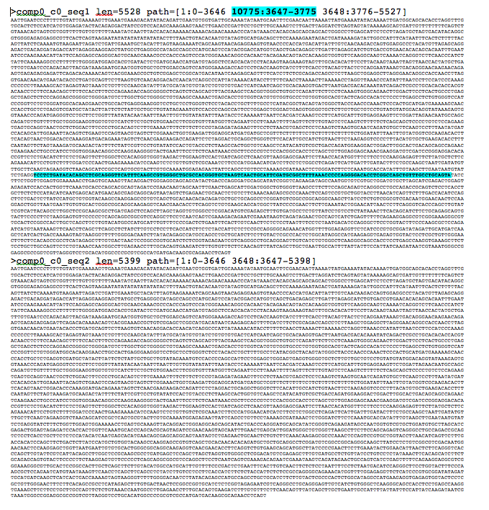
Trinity output: A multi-fasta file

Slide 58

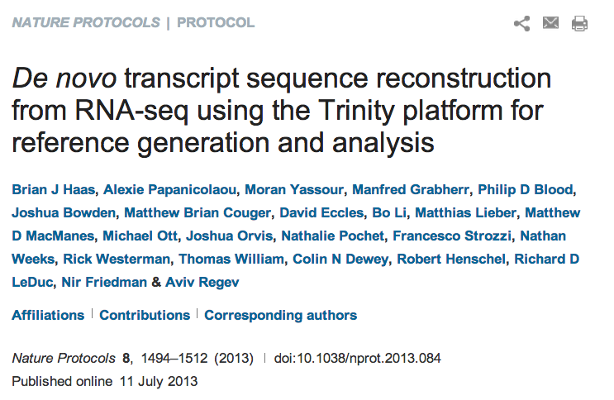
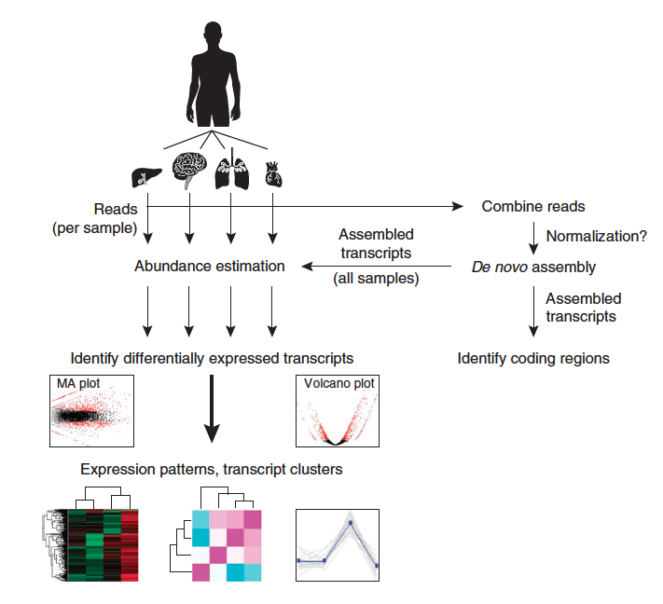
Notes:
Last year, we published a paper in Nature Protocols that outlines how you would perform a Trinity de novo assembly followed by supported downstream analyses including abundance estimation, differential expression analysis, and exploring patterns of transcript expression across multiple sample types.

Slide 59
Evaluating the quality of your transcriptome assembly
Read representation by assembly
Full-length transcript reconstruction
Contig N50 leveraging expression data (ExN50)
Detonate

Slide 60
Evaluating the quality of your transcriptome assembly
Read representation by assembly
Align reads to the assembled transcripts using Bowtie.
A typical ‘good’ assembly has ~80 % reads mapping to the assembly
and ~80% are properly paired.
Given read pair:
Possible mapping contexts in the Trinity assembly are reported:
Proper pairs
Improper pairs
Left only
Right only

Slide 61
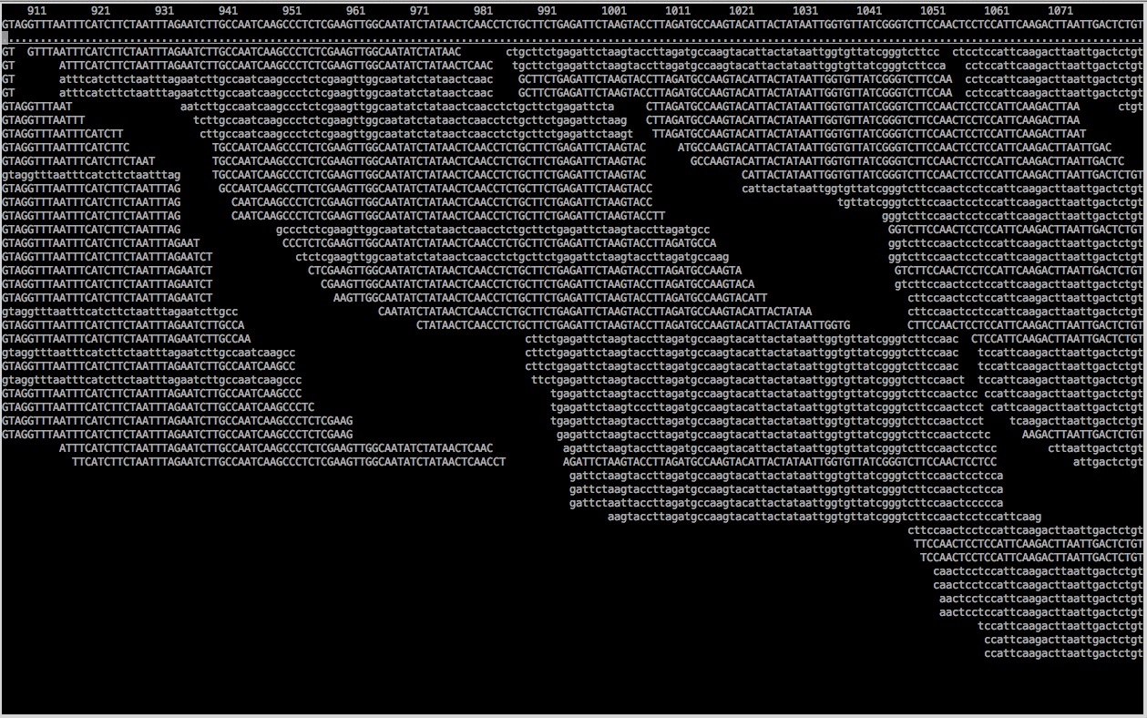
Assembled transcript contig is only as good as its read support.
% samtools tview alignments.bam target.fasta

Slide 62
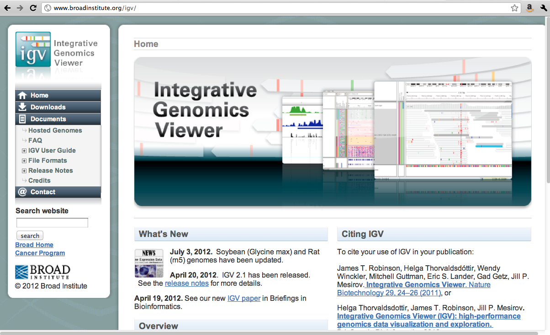
IGV

Slide 63
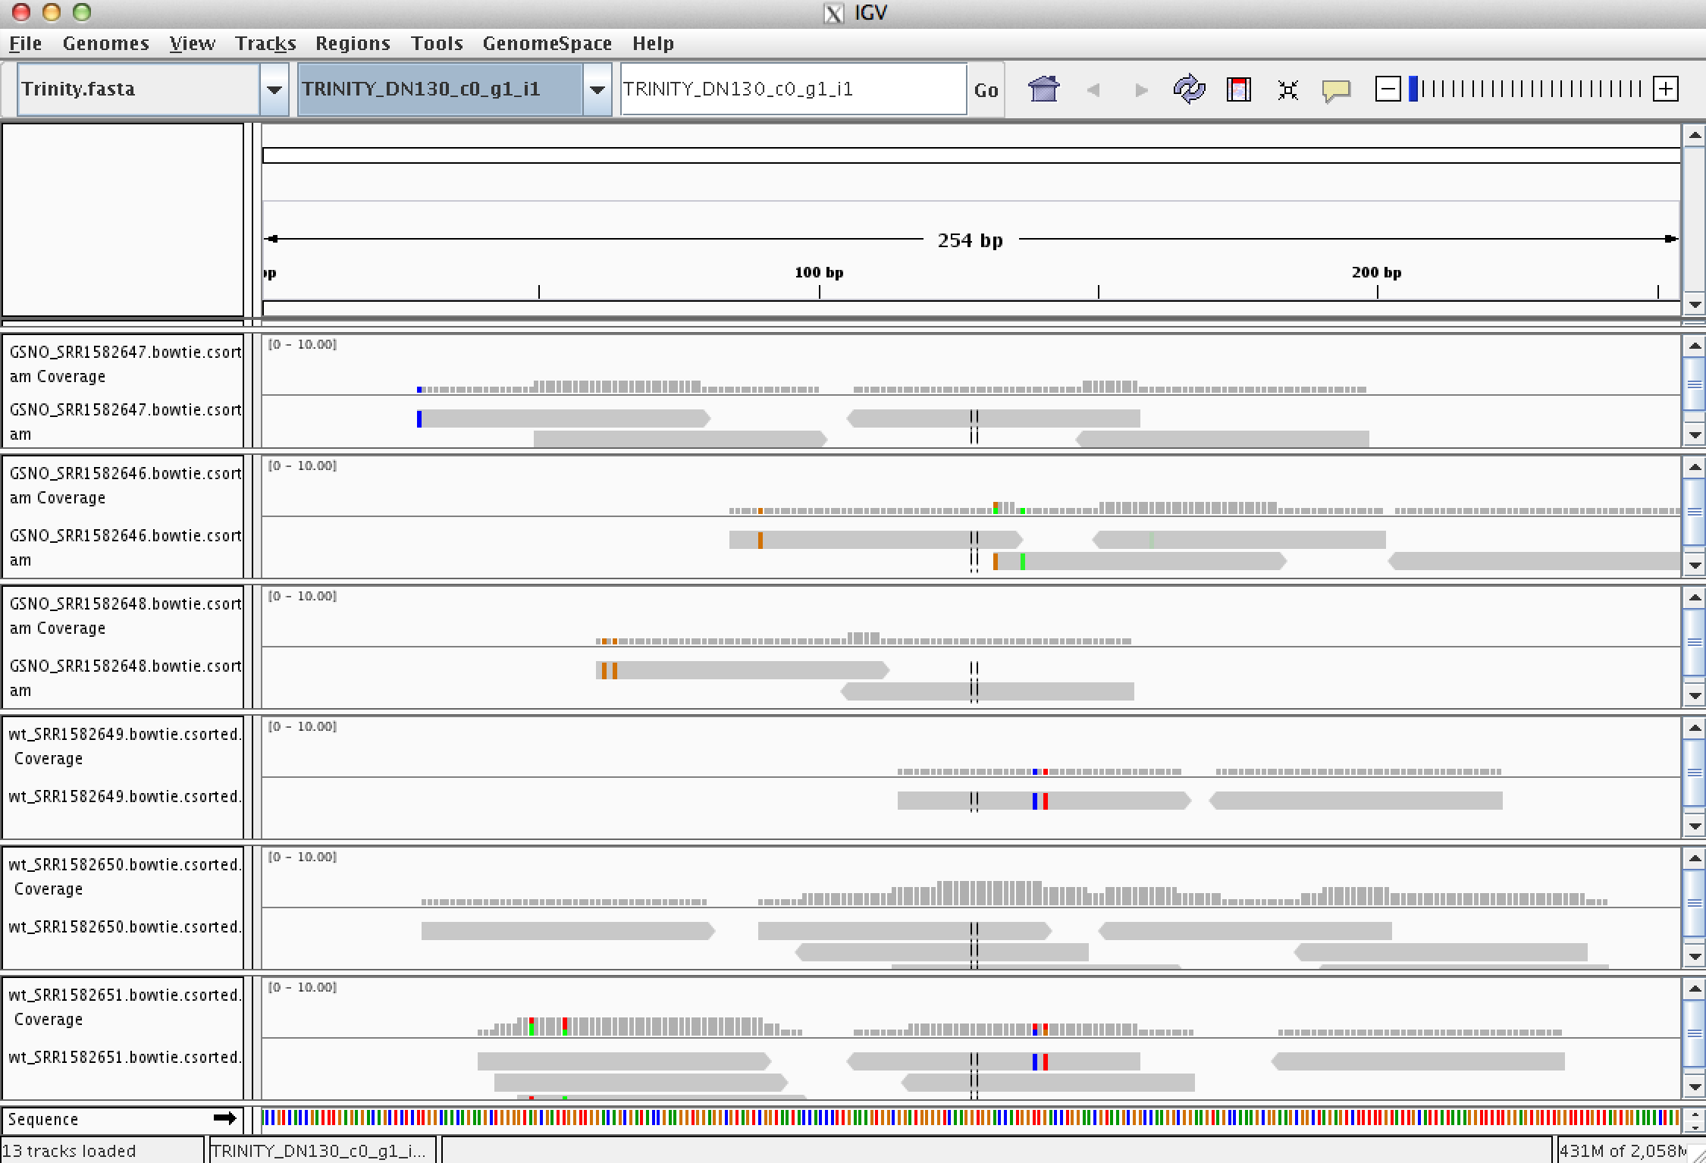
Can Examine Transcript Read Support Using IGV

Slide 64
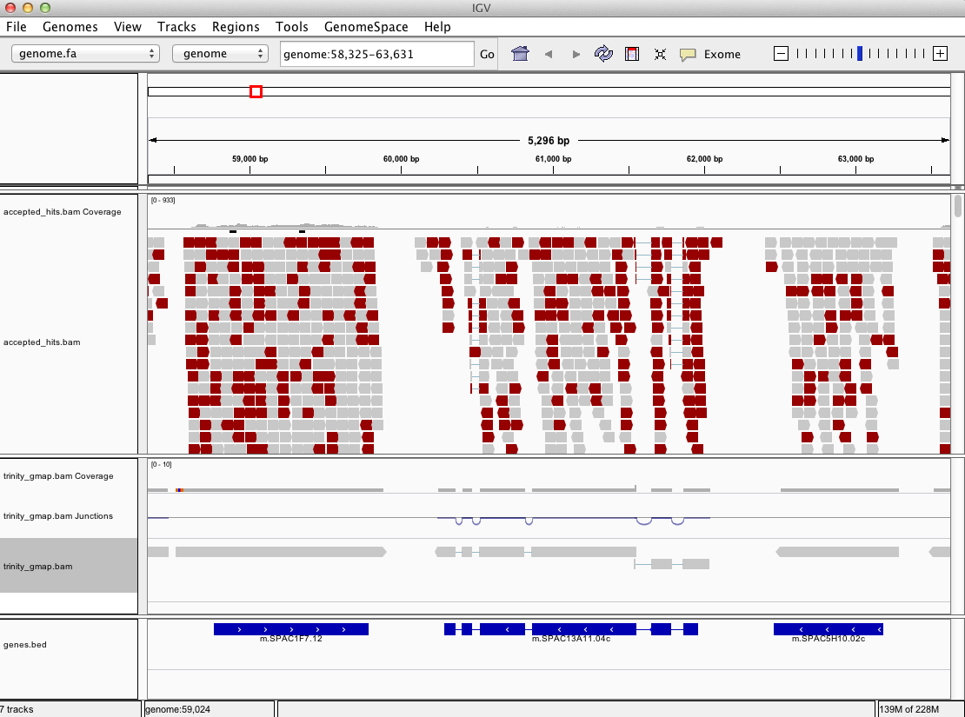
Can align Trinity transcripts to genome scaffolds to examine intron/exon structures
(Trinity transcripts aligned to the genome using GMAP)

Slide 65
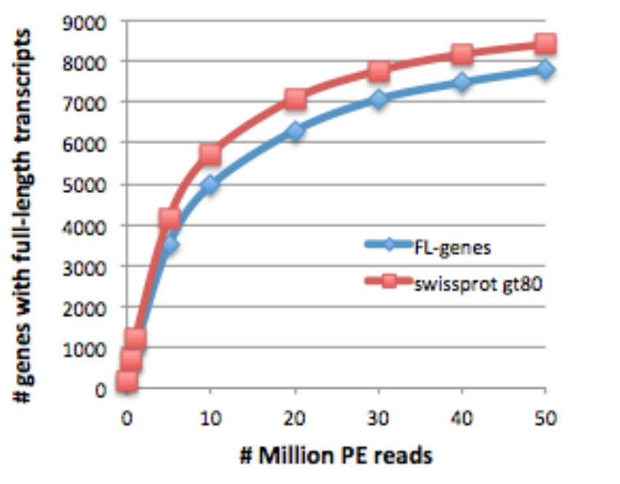
Evaluating the quality of your transcriptome assembly
Full-length Transcript Detection via BLASTX
M
*
Known protein (SWISSPROT)
Trinity transcript
Have you sequenced deeply enough?
* Mouse transcriptome
Haas et al. Nat. Protoc. 2013

Slide 66
The Contig N50 statistic
“At least half of assembled bases are in contigs that are at least ‘__N50__’ bases in length”
In genome assemblies – used often to judge ‘which assembly is better’
In transcriptome assemblies – N50 is not very useful.
Overzealous isoform annotation for long transcripts drives higher N50
Very sensitive reconstruction for short lowly expressed transcripts drives lower N50

Slide 67
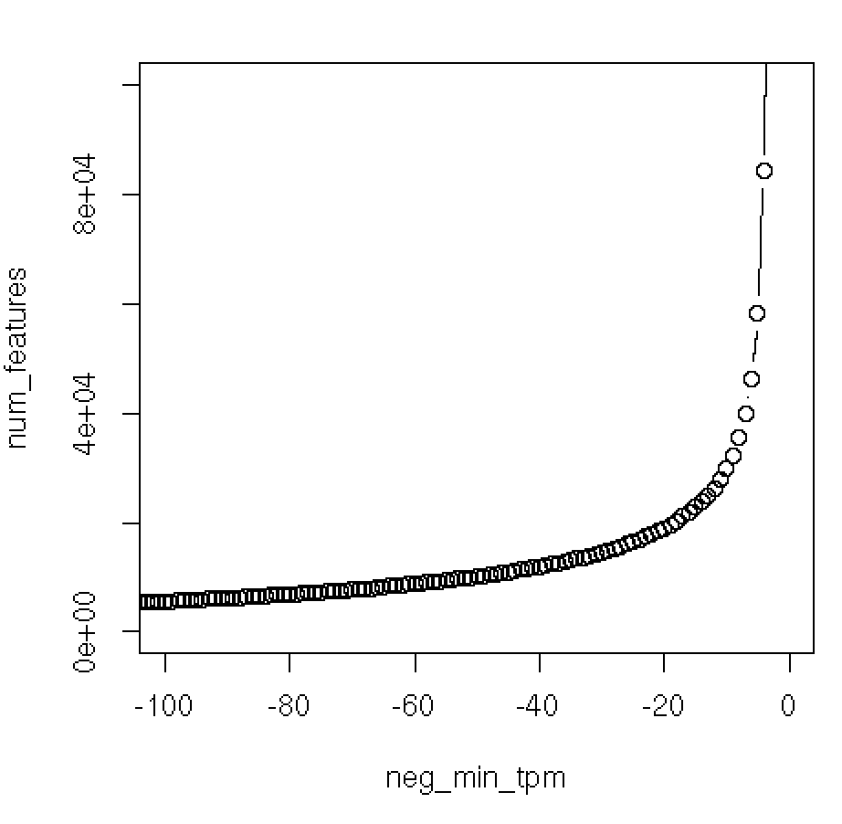
Often, most assembled transcripts are *very* lowly expressed
(How many ‘transcripts & genes’ are there really?)
1.4 million Trinity transcripts contigs
N50 ~ 500 bases
Cumulative
# of
Transcripts
20k transcripts
-1 * minimum TPM
Expression
* Salamander transcriptome

Slide 68
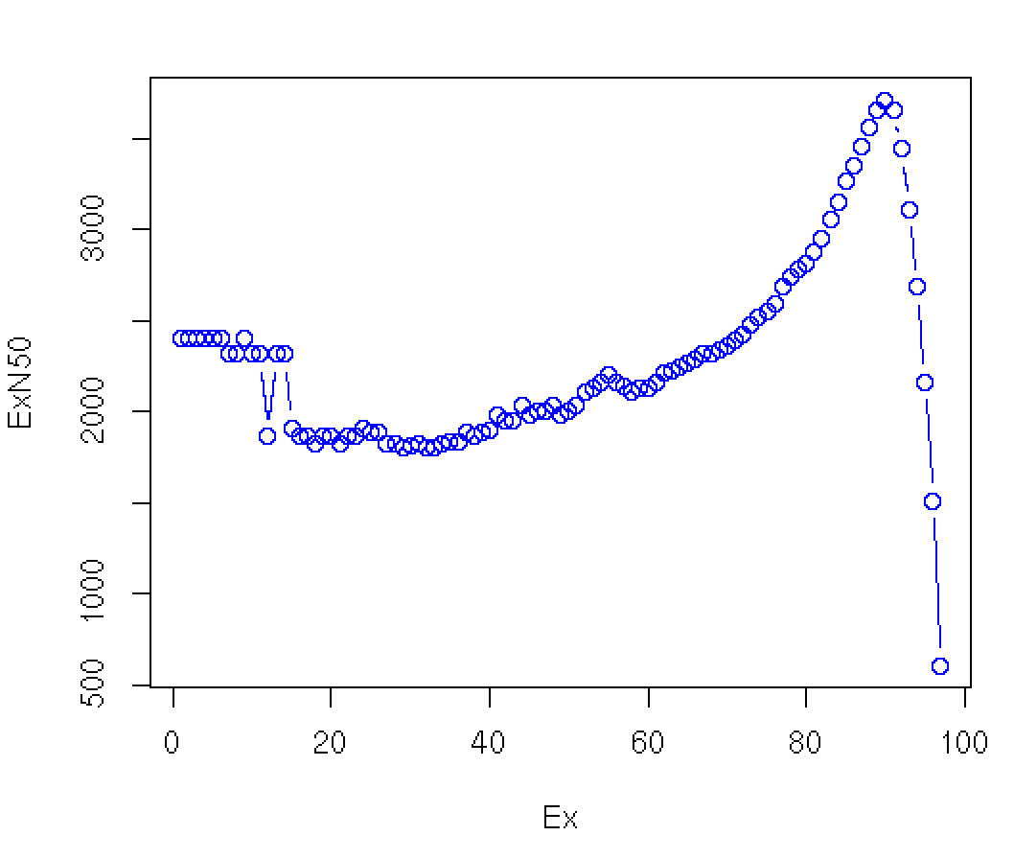
Compute N50 Based on the Top-most Highly Expressed Transcripts (ExN50)
Sort contigs by expression value, descendingly.
Compute N50 given minimum % total expression data thresholds => ExN50
N50=3457,
and
24K transcripts
90% of
expression data

Slide 69
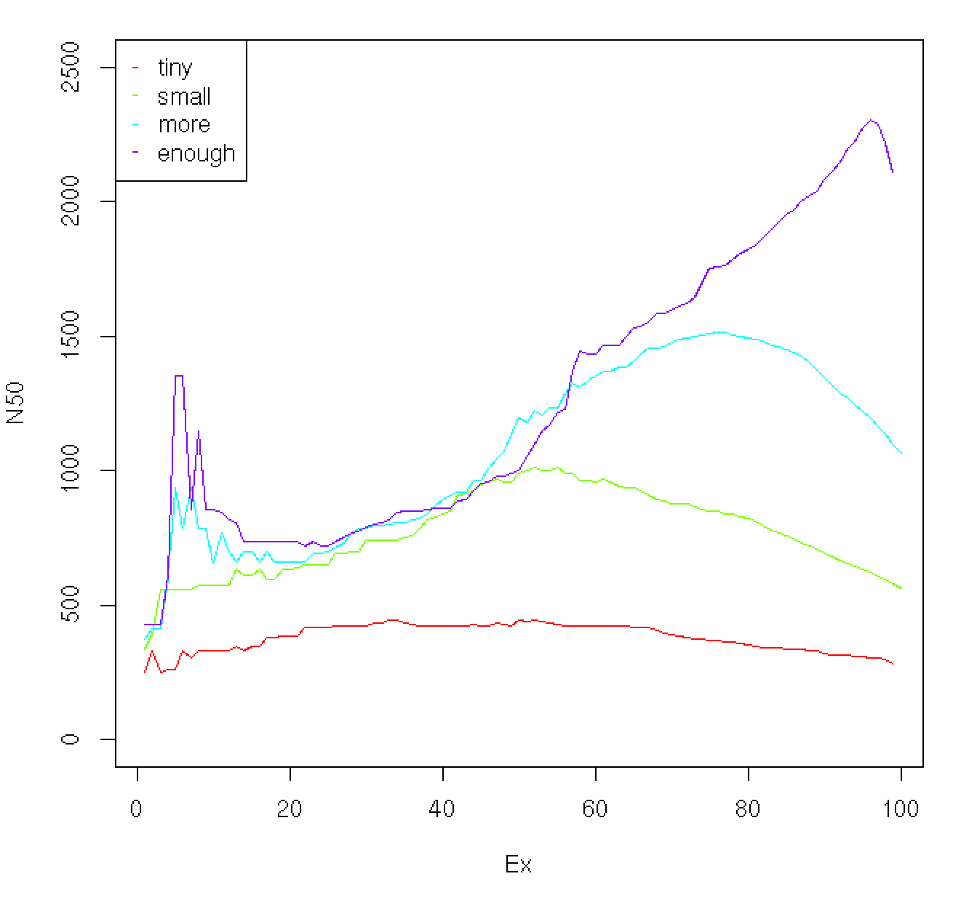
ExN50 Profiles for Different Trinity Assemblies Using Different Read Depths
Millions of Reads
Thousands of Reads
Note shift in ExN50 profiles as you assemble more and more reads.
* Candida transcriptome

Slide 70
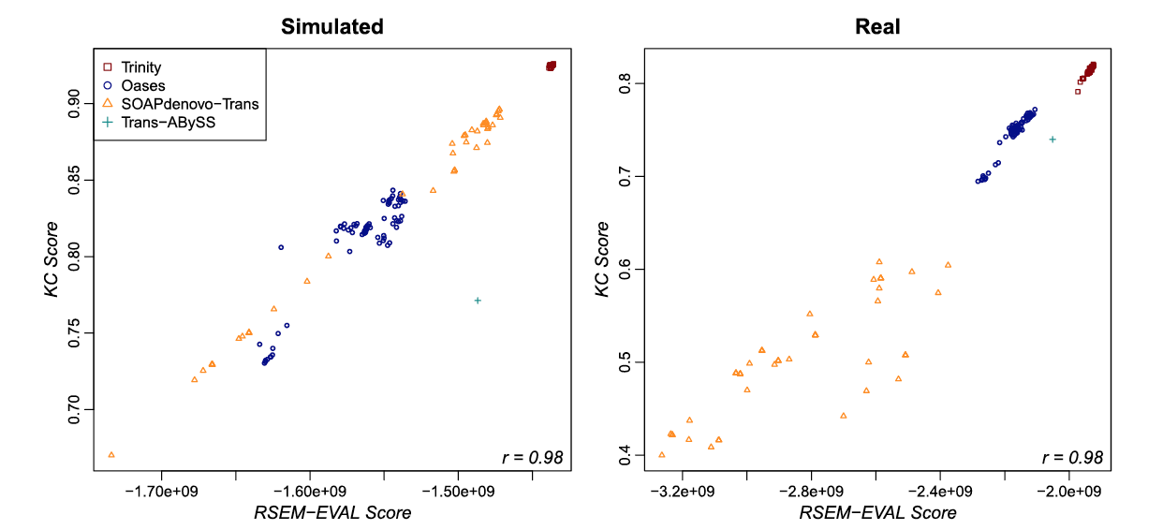
Detonate Software
“RSEM-EVAL [sic] uses a novel probabilistic model-based method to compute the joint probability of both an assembly and the RNA-Seq data as an evaluation score.”
Ref Genome –based metric
RSEM-EVAL Genome-free metric
Li et al. Evaluation of de novo transcriptome assemblies from RNA-Seq data, Genome Biology 2014

Slide 71
Abundance Estimation (Aka. Computing Expression Values)

Slide 72
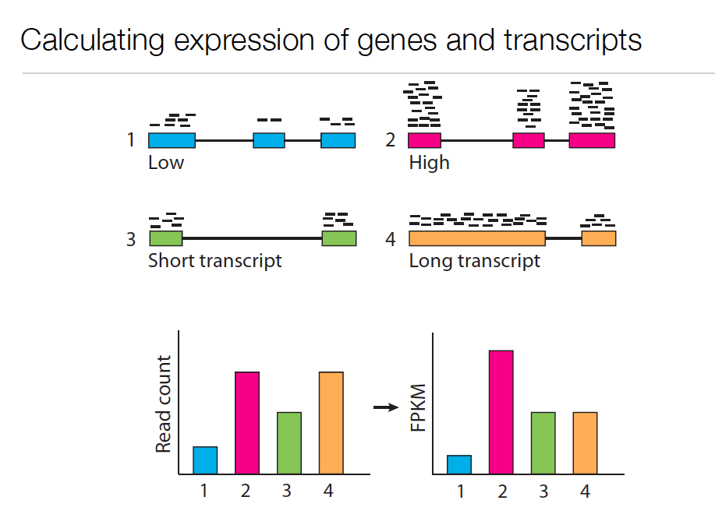
Expression Value
Slide courtesy of Cole Trapnell
Notes:
In RNA-Seq, the expression of a transcript is measured based on the number of RNA-Seq reads sampled that map to the corresponding transcript.
The number of reads sequenced for a transcript depends on a number of factors.
For one, the number of reads observed depends on the expression of the transcript. Transcripts that are expressed at higher levels should account for more reads in the sample than those expressed at lower levels if all else is equal.
Also, the sequencing depth must be taken into account. The deeper you sequence, the more reads you’ll observe mapping to transcripts at any expression level.

Slide 73
Expression Value
Slide courtesy of Cole Trapnell
Notes:
The number of reads corresponding to a transcript also depends on its length. Longer transcripts represent more real estate in the sequencing library than shorter transcripts expressed at the same level (number of transcripts per cell).

Slide 74
Normalized Expression Values
Transcript-mapped read counts are normalized for both length of the transcript and total depth of sequencing.
Reported as: Number of RNA-Seq Fragments Per Kilobase of transcript per total Million fragments mapped
FPKM
RPKM (reads per kb per M) used with Single-end RNA-Seq reads
FPKM used with Paired-end RNA-Seq reads.
Notes:
And so, when computing expression for transcripts, both the number of reads mapping to each transcript and the lengths of those transcripts must be taken into account.
The metric reported is often in units of FPKM.

Slide 75
Transcripts per Million (TPM)
Preferred metric for measuring expression
Better reflects transcript concentration in the sample.
Nicely sums to 1 million
Linear relationship between TPM and FPKM values.
TPM
Both are valid metrics, but best to be consistent.
FPKM

Slide 76

Multiply-mapped Reads Confound Abundance Estimation
Isoform A
EM
Isoform B
Blue = multiply-mapped reads
Red, Yellow = uniquely-mapped reads
Notes:
Accurately estimating transcript expression levels is actually much more complicated due to the fact that not all RNA-Seq reads are able to map uniquely to their corresponding transcript.
This is particularly the case for alternatively spliced transcripts. Such transcripts are not entirely identical, but can share a substantial amount of sequence in common, differing at sites of splicing variation, such as due to skipped exons or from differential splice site selection.
Here’s an example of the problem, where we have two isoforms A, B, with shared sequences in blue and isoform- unique sequences in yellow or red. Reads mapping to either the yellow or red sequences will map uniquely and unambiguously. However, the reads that map to the blue regions will map ambiguously. It isn’t obvious as to which transcript the reads were derived. Using sophisticated statistical inference methods, we can infer the likelihood of a blue read having been derived from one isoform or the other, by taking into account the number of uniquely mapping reads and the length of each isoform.

Slide 77
Multiply-mapped Reads Confound Abundance Estimation
Isoform A
EM
Isoform B
Use Expectation Maximization (EM) to find the most likely assignment of reads to transcripts.
Performed by:
Cufflinks and Cuffdiff (Tuxedo)
RSEM
eXpress
Blue = multiply-mapped reads
Red, Yellow = uniquely-mapped reads
New fast alignment-free methods now available! eg. Kallisto
Notes:
There are tools available that implement these methods, which rely on the technique of expectation maximization.
Expectation maximization involves cycling between estimating parameters of a statistical model based on the data, and computing likelihood estimates of results from applying those model parameters.
In this case, you can think of the algorithm as fractionally assigning the blue reads to each isoform and estimating the likelihood of those assignments. With each iteration of the algorithm, the read assignments become more likely, and eventually the likelihood will converge to a maximum value. Finally, the counts of reads assigned to each isoform are reported.

Slide 78
Differential Expression Analysis Using RNA-Seq
Notes:
Differential expression analysis in RNA-Seq involves comparing expression levels for genes across two or more different samples.
It is mostly an exercise in counting reads and doing statistics to determine if the counts are significantly different between conditions.

Slide 79

Cross-sample Normalization Required Otherwise, housekeeping genes look diff expressed due to sample composition differences
Subset of genes highly expressed in liver
Technical replicates
Liver - kidney
Robinson and Oshlack, Genome Biology, 2010
Notes:
Pushes relative concentration of the other liver transcripts down.

Slide 80
Why cross-sample normalization is important
Absolute RNA quantities per cell
Measured relative abundance via RNA-Seq
Cross-sample normalized (rescaled) relative abundance
Liver
Kidney
Liver
Kidney
Liver
Kidney
eg. Some housekeeping gene’s expression level:
TPM
TPM
TPM
L
K
L
K
L
K

Slide 81

Normalization methods for Illumina high-throughput RNA sequencing data analysis.
From “A comprehensive evaluation of normalization methods for Illumina high throughput RNA sequencing data analysis” Brief Bioinform. 2013 Nov;14(6):671-83
http://www.ncbi.nlm.nih.gov/pubmed/22988256

Slide 82
Diff. Expression Analysis Involves
Counting reads
Statistical significance testing
Sample_A
Sample_B
Fold_Change
Significant?
Gene A
1
2
2-fold
No
Gene B
100
200
2-fold
Yes

Slide 83

Observed RNA-Seq Counts Result from Random Sampling of the Population of Reads
Technical variation in RNA-Seq counts per feature is well modeled by the Poisson distribution
Mean # fragments
(observed read counts)
See: http://en.wikipedia.org/wiki/Poisson_distribution
Notes:
When we count reads, what we’re really doing is randomly sampling reads from a population.
Observed counts resulting from random sampling are well modeled by the Poisson distribution.
It has been shown that technical replicates of rna-seq samples, where it’s the same sample (which should show no differentially expressed transcripts), yield distributions of counts that are well modeled by Poisson.

Slide 84


Example: One gene*not* differentially expressed
SampleA(gene) = SampleB(gene) = 4 reads
Distribution of observed counts for single gene (under Poisson model)
Dist. of log₂(fold change) values
same
SampleA(geneX)
SampleB(geneX)
2-fold diff
density
density
4-fold diff
(k) number of reads observed
x = log₂(SampleA/SampleB)

Slide 85

Beware of concluding fold change from small numbers of counts
Poisson distributions for counts based on 2-fold expression differences
No confidence in 2-fold difference. Likely observed by chance.
High confidence in 2-fold difference. Unlikely observed by chance.
P(x=k)
Observed Read Count (k)
From: http://gkno2.tumblr.com/post/24629975632/thinking-about-rna-seq-experimental-design-for
Notes:
Can’t deduce with confidence that the transcripts are two-fold differentially expressed based on the distribution of observed counts. Sequence deeper.
Poisson noise limits the ability to confidently detect differential expression with small values of read counts.

Slide 86
More Counts = More Statistical Power
Example: 5000 total reads per sample.
Observed 2-fold differences in read counts.
SampleA
Sample B
Fisher’s Exact Test
(P-value)
geneA
1
2
1.00
geneB
10
20
0.098
geneC
100
200
< 0.001

Slide 87


Tools for DE analysis with RNA-Seq
edgeR
ShrinkSeq DESeq
baySeq
Vsf
Limma/Voom
mmdiff
cuffdiff
ROTS
TSPM
DESeq2
EBSeq
NBPSeq
SAMseq
NoiSeq
(italicized not in R/Bioconductor
but stand-alone)
See: http://www.biomedcentral.com/1471-2105/14/91

Slide 88
Visualization of DE results and Expression Profiling

Slide 89


Plotting Pairwise Differential Expression Data
Volcano plot
( fold change vs. significance)
MA plot
(abundance vs. fold change)
Log₁₀ (Pvalue)
Log₂ (fold change) (A of MA)
Log₂ (fold change)
Log₂ Average Expression level (M of MA)
Significantly differently expressed transcripts have FDR <= 0.001
(shown in red)

Slide 90

Comparing Multiple Samples
Heatmaps provide an effective tool for navigating differential expression across multiple samples.
Clustering can be performed across both axes:
-cluster transcripts with similar expression patters.
-cluster samples according to similar expression values among transcripts.

Slide 91

Examining Patterns of Expression Across Samples
Can extract clusters of transcripts and examine them separately.

Slide 92

GO-Seq
http://trinotate.sf.net
Notes:
For annotating our reconstructed transcripts, we leveraged our Trinotate software, which uses BLAST, PFAM, and several other bioinformatic resources and tools to assign likely functions to transcripts and putative coding regions of transcripts.
We recently incorporated GO-Seq into the system to enable functional enrichment of gene ontology categories based on expression studies, and we found it particularly useful in this salamander transcriptome study.

Slide 93

Trinotate Web for Interactive Analysis

Slide 94


Deciphering the Cell Circuitry of Limb Regeneration Via Single Cell Transcriptome Studies
Work done in collaboration with
Jessica Whited’s lab

Slide 95

Axolotl (Ambystoma mexicanum) Transcriptomics
Axolotl "water monster”, aka Mexican salamander or Mexican walking fish.
Model for vertebrate studies of tissue regeneration
Short generation time
Can fully regenerate a severed limb in just weeks.
Genome estimated at ~30 Gb (not yet sequenced)
Notes:
Among salamander species, Axolotl is a favored model for studies of vertebrate limb regeneration.
It’s an aquatic salamander.
It’s favored due to its short generation time, its easy to rear in the lab,
and because it can quickly regenerate a severed limb in just a matter of weeks.
Salamanders, in general, have massive genomes, and none have been sequenced yet, but that’s expected to change soon given the rapid advancements in genome sequencing technologies.

Slide 96

Key morphological steps during limb regeneration
wound epidermis
blastema
24 hours
1 week
1 week
1 week
2-3 weeks
Notes:
The key morphological steps of limb regrowth in the axolotl are shown here.
Upon losing a limb (such as by an unfortunate encounter with a pair of scissors), the stump quickly heals the wound by growing a thin layer of skin called the wound epidermis (shown in red).
Under the wound epidermis, localized tissue breaks down, cells dedifferentiate, and stem cells are recruited to form a structure called the blastema.
Over the course of a couple of weeks, the blastema continues to grow and project outward, eventually resembling the shape of the limb with digits, and finally reconstituting the entire fully functional replacement limb.
----
We’re very interested in the the process of blastema development and in using the power of next generation sequencing and related tools to gain greater insights into the events underlying blastema development and limb regrowth.

Slide 97

Jessica Whited, Mark Mannucci, Ari Haberberg
Notes:
Here’s a short video that follows one of her Axolotls through the process of limb regeneration. We left out the scissors.
You can see the blastema form at the site of amputation. Soon after extension of the blastema, you can start to make out the digits, and over the course of the next couple of weeks the limb continues to grow and develop, and soon it’s good as new.

Slide 98




1. Building a reference Axolotl transcriptome
1.3 billion of 100 bp paired-end Illumina reads
limb tissues and select other tissues with biological replicates
Notes:
Since there’s no genome, we set out to develop a comprehensive transcriptome resource to support our further studies of tissue regeneration.
We sampled a wide array of different tissues including sections of limb, gill, bone, cartilage, blastema clumps from severed limbs (proximally or distally along the limb), skeletal muscle, heart, blood vessels, testes, and ovaries.
We sequenced a total of 1.3 billion Illumina reads distributed across the tissue samples including biological replicates,
and we assembled the reads into transcripts by using the Trinity de novo rna-seq assembly tool, which is a tool that I helped to develop and I continue to maintain.

Slide 99


Framework for De novo Transcriptome Assembly and Analysis
1.3 Billion
Total Reads
86 Million
Normalized Reads
Bowtie & RSEM
EdgeR,
Bioconductor,
& Trinity
Notes:
Here’s a zoomed-in view of the generic protocol, which we applied here in this study.
In our case, we’re applying it to axolotl and the various axolotl tissues.
We combined all the reads into one large set of 1.3 billion reads.
This large volume of reads is in far excess of what’s needed for a de novo assembly and contains massive redundancy of reads that correspond to the most highly expressed transcripts. So, in this case, we ran the reads through an insilico normalization process that’s included in the Trinity suite to remove the excess reads, while retaining those reads that correspond to the lowly expressed transcripts. This resulted in 86 Million reads, which were then assembled using Trinity.
The original reads from the various samples and replicates were then separately aligned to the Trinity assembly in order to estimate expression levels, and this was done using Bowtie/RSEM.
Finally, EdgeR, Bioconductor, and various helper utilities in the Trinity distribution were used to analyze these data to identify differentially expressed transcripts.

Slide 100
Axolotl Transcriptome De novo Assembly Statistics
And Quality Assessment
ExN50 looks good!
In silico Normalization
1.3 B
Counts of Transcripts
N50=3457,
and
24K transcripts
Trinity contigs (transcripts) | 1,701,035
Trinity components (genes) | 1,327,843
86 M
Min. length 200 bases
Percent of Non-normalized Fragments Mapping as Properly Paired to Transcriptome
77% avg
Blood Vessel
Gill
Bone
Cartilage
(Long)
Cartilage
(Wrist)
Ovaries
Testes
Blastema
(Distal)
Elbow
Forearm
Hand
Heart
Blastema
(proximal)
Skeletal Muscle
Upper Arm
✗
✗
✗
✗
Notes:
Here are some stats for the assembly.
Again, before doing the assembly, the normalization process removed the majority of the reads as excess. Assembling the remaining reads yielded a very large assembly containing 1.7 million transcript contigs that were grouped into 1.3 million components. Here, we refer to the trinity contigs and components as transcripts and genes. This is definitely the largest number of transcripts I’ve assembled using Trinity, but it’s also the most complex data set that I’ve assembled using Trinity as well.
Although we assembled a relatively small proportion of the total number of reads, we have excellent representation of the full read set among the various samples, with on average 77% of reads mapping back to the assembly as properly paired. If we didn’t require proper pairing, these stats would be even higher.
The Contig N-stats look reasonably well. We tend to expect the contig N50 size to approximate the average length of a reference transcript, which is typically between 1 and 2 kb. Here, we find the contig N50 length to be just over 1kb and the N40 length to be just less than 2kb, so within the expected range.

Slide 101




Biological Replicates Cluster According to Sample
Correlation
Tissues
0.4 0.7 1
Cartilage
Bone
Blastema
Tissues
Blood Vessel
Heart
Arm
Gill Filament
Ovaries
Skeletal Muscle
Testes
Pearson Correlation Matrix for Tissue Replicates
Notes:
When we cluster each of the samples according to gene expression values, we find the biological replicates to be highly correlated.
And samples that are similar to one another tend to cluster together. For example, cartilage and bone cluster together, and blood vessel and heart cluster together. All the various parts of the arm co-cluster.
Testes, perhaps not surprisingly, shows up as an outgroup and is least correlated with all the other samples.

Slide 102
Identification of Tissue-enriched Expression
Skeletal Muscle
Cartilage
Bone
Arm
Blood Vessel
All Pairwise DE Comparisons
Blastema
Heart
Testes
Ovaries
Gill Filament
EdgeR, min 4-fold change, FDR <= 1e-3
Notes:
To identify hallmarks of expression in each tissue type, we performed a differential expression analysis between all sample pairs using edgeR, and we identified those genes that were consistently enriched within a tissue across each of the pairwise comparisons.
For example, in the case of Blastema, we wanted to identify all the transcripts that are found consistently enriched in blastema tissue as compared to each of the other tissue types, and might represent key functions for blastema tissue.

Slide 103


Identification of Tissue-enriched Gene Expression
Tissues
Arm (193), GO: thick ascending limb development [8.8e-5]
Ovaries (1225)
Skeletal Muscle (539)
Genes
Testes (4113), GO: spermatogenesis [2.5e-14]
Blood Vessel (939)
Bone (272), GO: myeloid leukocyte differentiation [2.2e-3]
Blastema (202): limb morphogenesis [2.5e-5]
Cartilage (255), GO: collagen fibril organization [4.5e-10]
Gill Filament (765)
EdgeR, min 4-fold change, FDR <= 1e-3
Heart (238), GO: vascular process in circulatory system [2.6e-3]
Functional enrichment using GO-Seq
Notes:
Using this fairly stringent approach, we identified hundreds to thousands of genes found consistently enriched in expression for the various tissues.
Most of the tissue-enriched genes (>4k) were identified in Testes, which again is not surprising given how its expression is least correlated with the other samples.
The functional category enrichments for these genes were often consistent with the function of that tissue – for example, spermatogenesis in Testes, vascular process in heart.
----
In the case of our blastema tissue, we identified just over 200 hundred genes functionally enriched for limb morphogenesis, and these are the genes we’re most interested in.

Slide 104




Most Highly Expressed Blastema-enriched Genes
Log2(FPKM)
CIRBP (cold-inducible) RNA-binding protein
RABP2 Retinoic Acid Binding Protein 2
MFAP2: Microfibrillar-associated protein 2
MKA: Pleiotrophic factor-alpha-1
GPC6: Glypican
FBN2: Fibrillin
TENA: Tenascin
HES1: transcription factor
CXG1: connexin
RAI4: cytoskeleton & cell-cell adhesion
VWDE: von Willebrand factor D and EGF
KERA: Keratacan
K2C6A: Keratin, cytoskeletal
TWIST: transcription factor (pt. 2 of 2)
TWIST: transcription factor (pt. 1 of 2)
KAZD1: growth factor binding protein
Color key:
Regulator
Signaling
Structure and Extracellular Matrix
Notes:
Here’s a zoomed in view of those most highly expressed blastema-enriched genes. Among these, we find several genes with functions that are likely to be playing key roles in the blastema.
These include genes that are involved in modulating gene expression, including CIRBP which stands for cold inducible rna-binding protein and the DNA-binding transcription factors HES1 and TWIST.
We also find genes involved in signaling such as retinoic acid binding protein 2 and KAZD1 growth factor binding protein, and we find other genes that appear to have roles in cell structure or interaction with the extracellular matrix.
---
Now that we have technologies to study transcriptomes at the level of individual cells, we’re curious to know if there’s heterogeneity in the expression of these genes among blastema cells, and if expression is limited to certain subpopulations of cells.

Slide 105


Functional Characterization of Blastema-enriched KAZD1
RT-PCR Timecourse of KAZD1 Expression
Days post-amputation
Notes:
Overexpressed kazd1 by infecting blastema cells with a replication incompetent retrovirus which gets stably inherited, expressing both Kazd1 and GFP (control).
Caused regeneration defects – control animals having very few regeneration abnormalities as compared to those w/ overexpression of kazd1.
We’re in the process of trying to generate knock-outs.

Slide 106
Summary of Key Points
RNA-Seq is a versatile method for transcriptome analysis enabling quantification and novel transcript discovery.
Expression quantification is based on sampling and counting reads derived from transcripts
Fold changes based on few read counts lack statistical significance.
Trinity assembly and supported downstream computational analysis tools facilitate transcriptome studies.

Slide 107




Acknowledgements
Aviv Regev
Brian Haas
Timothy Tickle
Asma Bankapur
Nathalie Pochet
Thomas Doak
Carrie Ganote
Robert Henschel
Ben Fulton
Salamander limb regeneration
Jessica Whited
Tia DiTommaso
Tae Lee
Anna Guzikowski
Jill Mesirov
James Robinson
Notes:
Here we acknowledge the primary contributors to this effort, including principal investigators Aviv Regev and William Barnett.
And we give additional thanks to ITCR for funding these efforts.

